Slide 1
Dashboard Presentation
Analyzed by: Md. Zubayer Hasan

Slide 2
Project Goal
Focused on analyzing key performance metrics.
Identify high-performing products, categories, and territories
Analyzing discount and pricing strategies
Recommendation above trends

Slide 3
Data collection and preprocessing
Dataset: Sales transaction records provided by Sokrio Technologies.
Preprocessing: Handled null values, Created calculated measures and columns.

Slide 4
Data collection and preprocessing
Cleaning
Handled missing values:
Detected null entries in the dataset.
Replaced missing values.
Processed directly in Power BI before visualization
Calculated measures:
Used categorization (e.g., Unknown) where appropriate.
Create new column (e.g., Discount Group).

Slide 5
Analysis
Descriptive Analysis:
Revenue trends Over Time
Product-Category wise Total Volume Percentage
Product performance
Territory Contribution
Diagnostic Analysis:
Impact of Discounts
Percentage of Highly Returned Sub-category
Predictive Analysis:
Next 6 Months Revenue Prediction

Slide 6
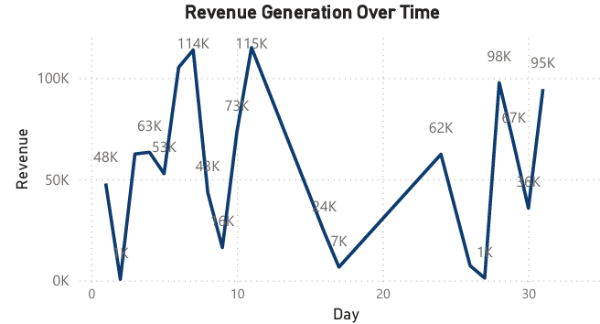
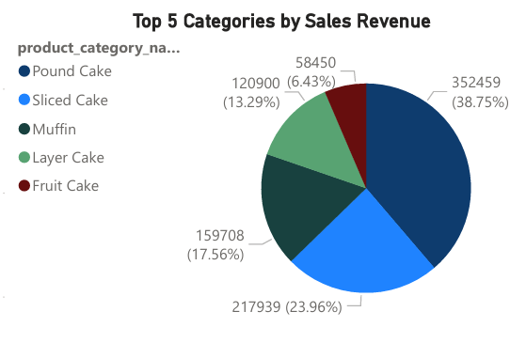
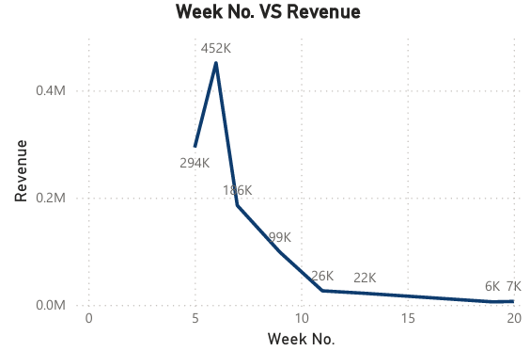
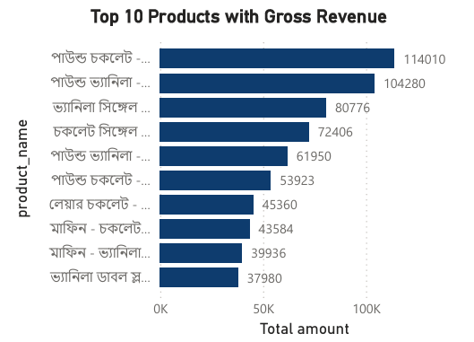
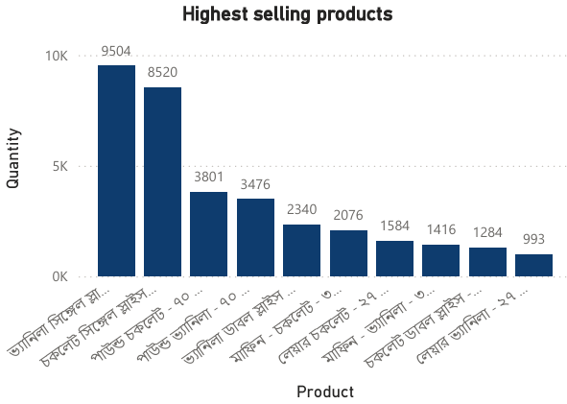
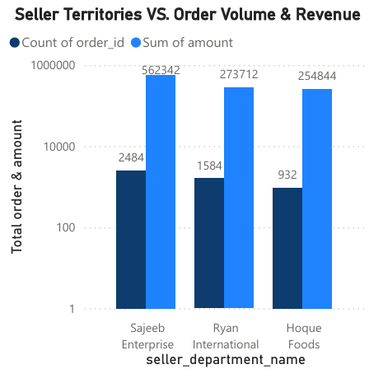
Descriptive Analysis

Slide 7
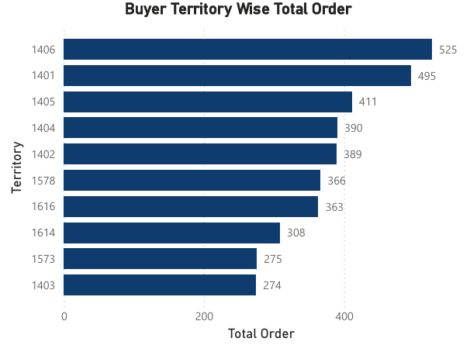
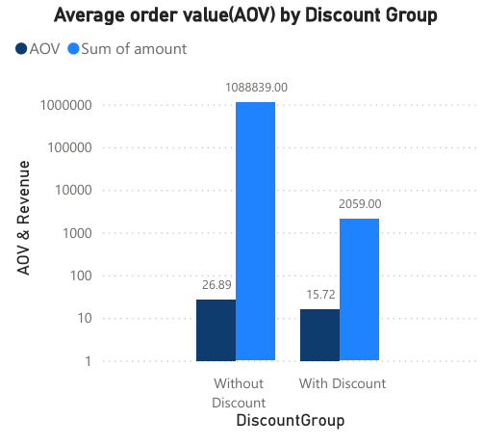
Diagnostic Analysis

Slide 8
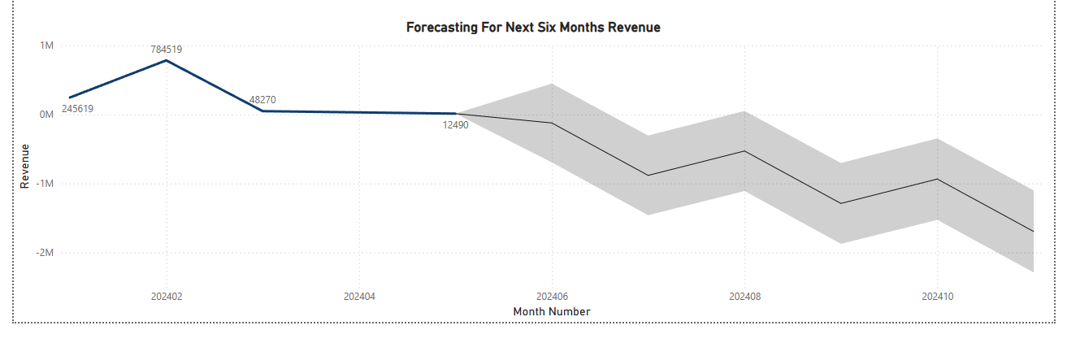
Predictive Analysis

Slide 9
Key Performance Indicators
Gross Revenue(BDT)
1090898
Unique Product Category
14
Total Orders
41K
Unique Product
41

Slide 10
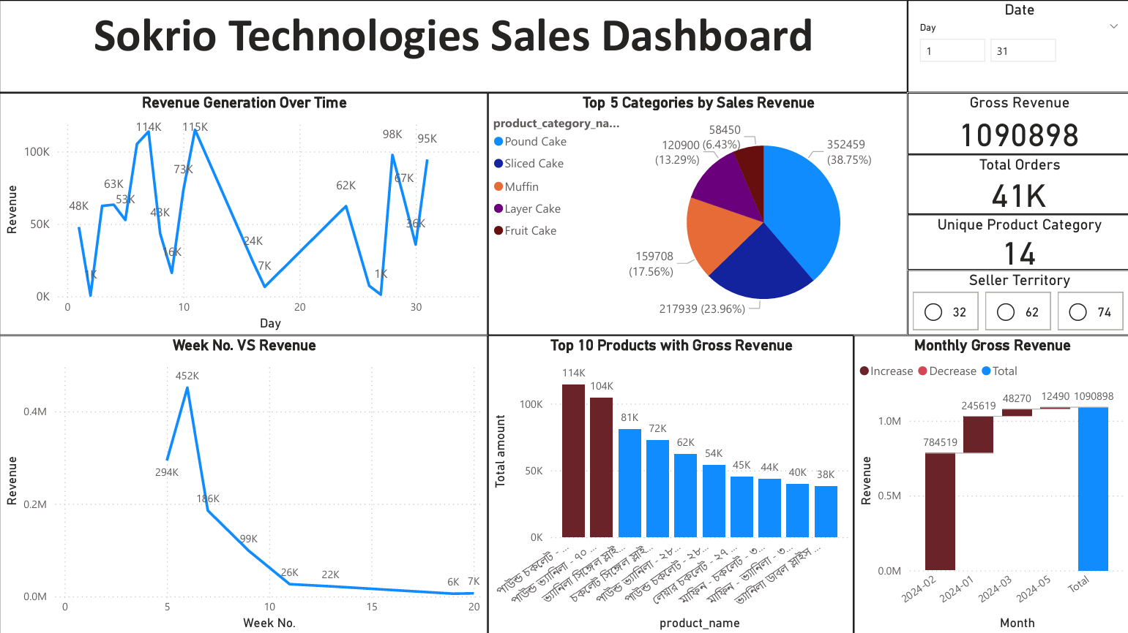

Slide 11
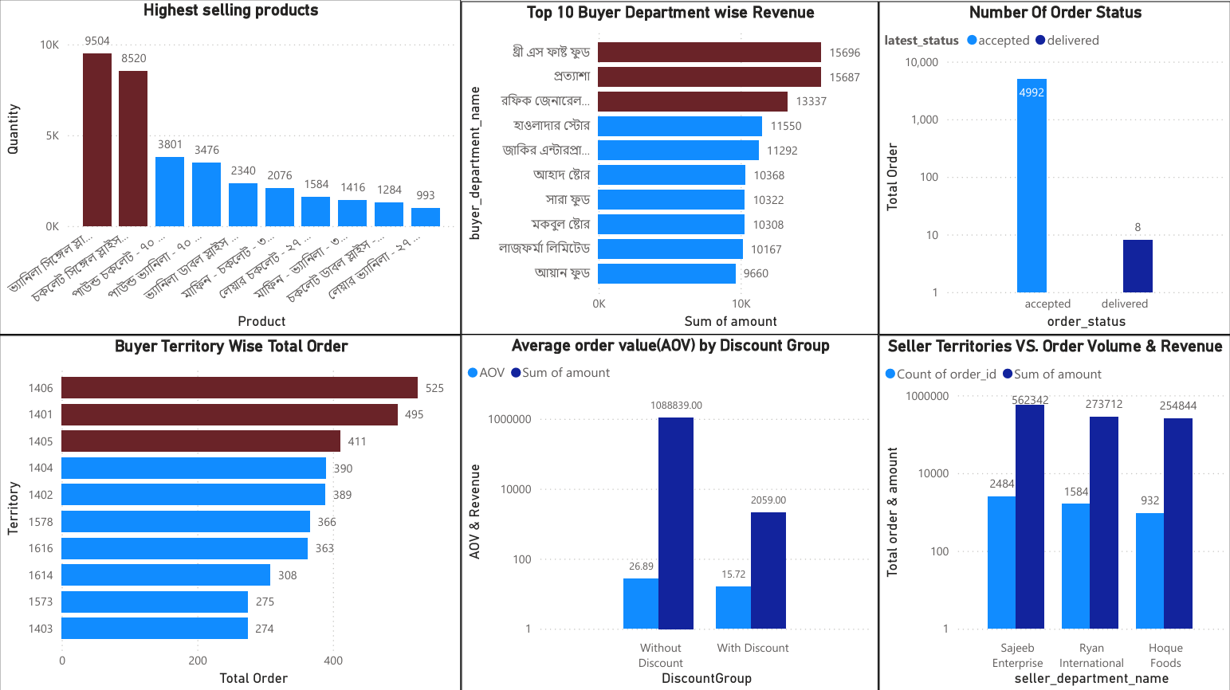

Slide 12
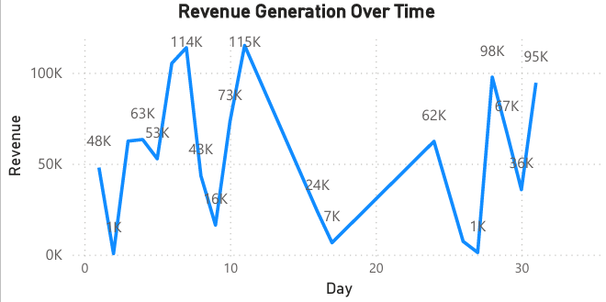
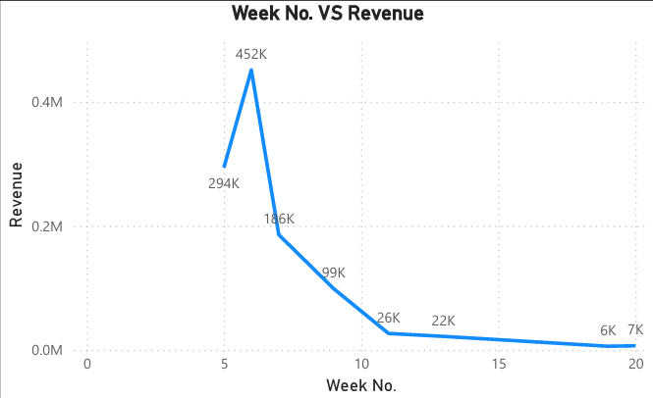
Key Insights and Diagnoses
Revenue Trend: Peaks in February, dip in May.
Week No. VS Revenue: High Revenue in Week-6.

Slide 13
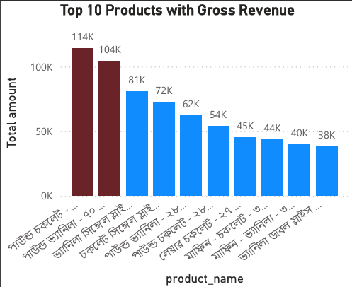
Key Insights and Diagnoses
Top Performing Products:
Pound Cakes and Sliced Cakes generated the highest revenue.

Slide 14
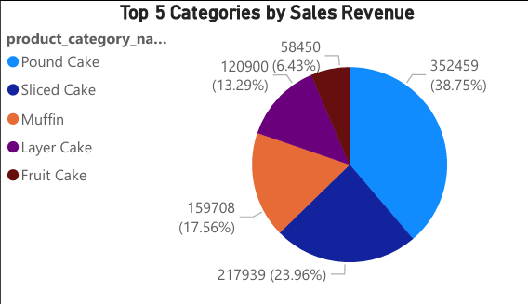
Key Insights and Diagnoses
Category Contribution:
Pound Cake contributed nearly 39% of total sales revenue, followed by Sliced Cakes (24%).

Slide 15
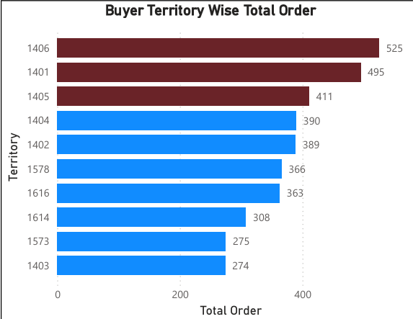
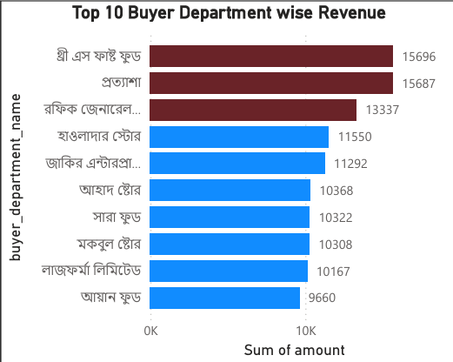
Key Insights and Diagnoses
Buyer Territory Performance:
Certain territories (e.g., IDs 1406, 1401, 1405) dominated in order volumes.
Buyer Department Insights:
A small set of buyer departments contributed disproportionately to revenue.

Slide 16
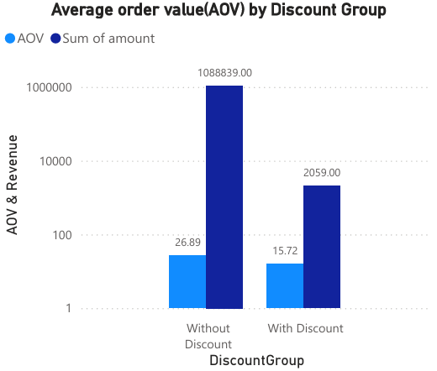
Key Insights and Diagnoses
Impact of Discounts:
Orders without discounts had a higher Average Order Value (≈ 26.9) compared to with discounts (≈ 15.7).

Slide 17
Key Insights and Diagnoses
Revenue Forecast:
The forecast model predicts a continued downward trend in revenue.

Slide 18
Final Findings
Sales are highly concentrated in a few products and categories(Pound Cake, Slice Cake,etc).
Revenue depends heavily on specific territories and buyers.
Discounting strategy is hurting Average Order Value rather than boosting overall sales.
Strong seasonal variations in sales suggest planning issues in production or distribution.

Slide 19
Recommendations
Product Strategy: Invest in marketing and expanding mid-performing categories (e.g., Muffins, Layer Cakes) to diversify revenue sources.
Territory Growth: Strengthen distribution in underperforming regions by replicating sales strategies from top territories.
Discount Optimization: Shift from blanket discounts to targeted promotions, focusing on bundles, seasonal demand, and specific customer segments — to boost sales without reducing overall profitability.
Buyer Engagement: Develop loyalty programs for key buyer departments to secure repeat orders while expanding into new client bases.
Diversify seller department contributions to reduce dependency risk.

Slide 20
Thank You

